Slide 1
E400 E Class In Road Installations

Slide 2
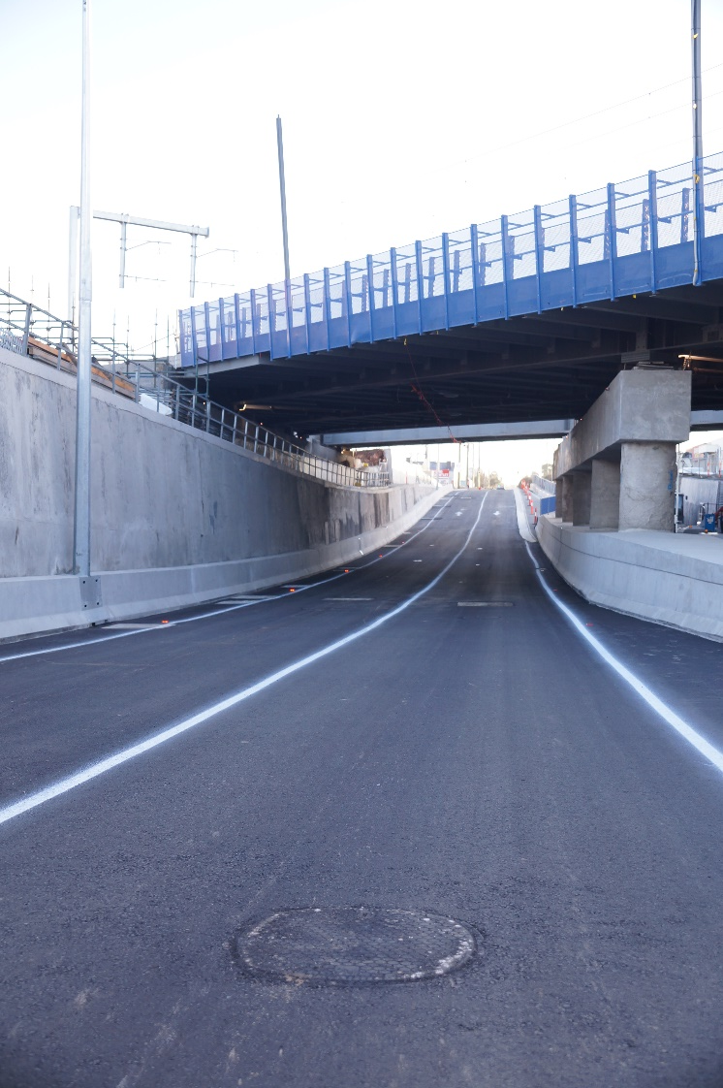
Andersons Rd Underpass, Sunshine Victoria- Regional Rail Link Project
Client: THIESS RRL Footscray – Deer Park/ VicRoads
Project Overview:
Project:
Andersons Rd Underpass, Stormwater Detention System – Assess Covers
Problem:
Routine 6 monthly inspections of system. High traffic area requiring lane closures during inspection & maintenance activities.
Need:
Lightweight, easy to open, strong manhole covers.
Must withstand heavy vehicle traffic.
Solution:
Terra Firma E400 ER-60 composite frame & cover
Cover weight 28kg
NATA tested to AS3996 Class E (400kN).
Can be opened in seconds with specialised seal breaker / lifter.
,

Slide 3
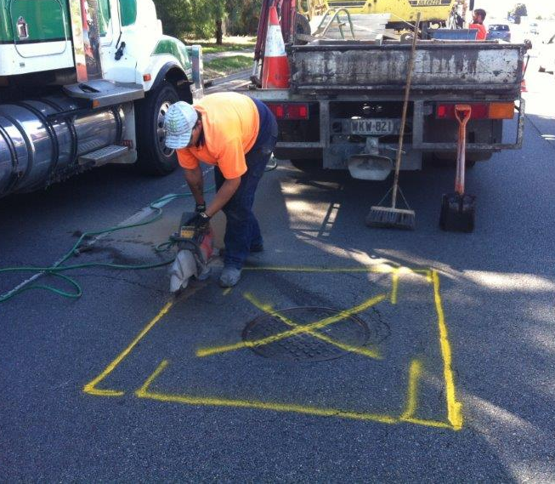
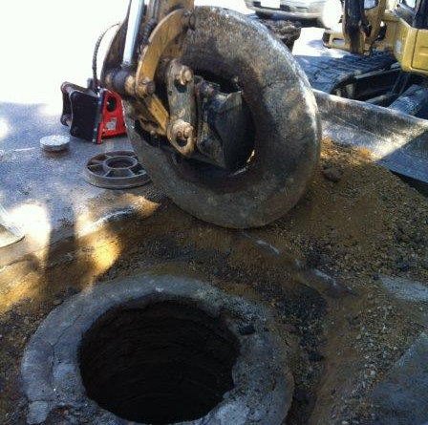
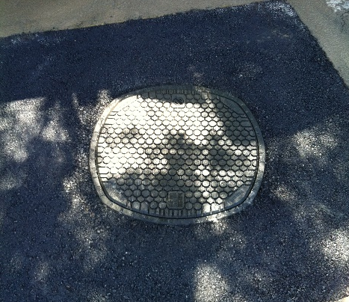
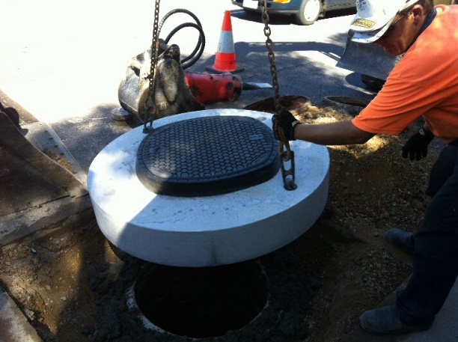
Kings Rd Salisbury- South Australia
Client: Southside Hire Pty Ltd/ SA Water
Project Overview:
Project:
Sewerage Manhole Cover Replacement -Kings Rd Salisbury SA
Problem:
Existing ductile iron cover sitting low in frame.
Rattling of cover in frame & signs of surrounding structure failure.
Need:
Gas tight/ water tight, lightweight, easy to inspect, strong pit lids
Must withstand heavy vehicle traffic
Solution:
Terra Firma E400 ER-60 composite frame & cover
Gas tight/ water tight seal. Cover weight 28kg
NATA tested to AS3996 Class E (400kN).
Composite fibreglass materials suitable for aggressive H2S environments.
Can be opened in seconds with specialised seal breaker / lifter.
,

Slide 4
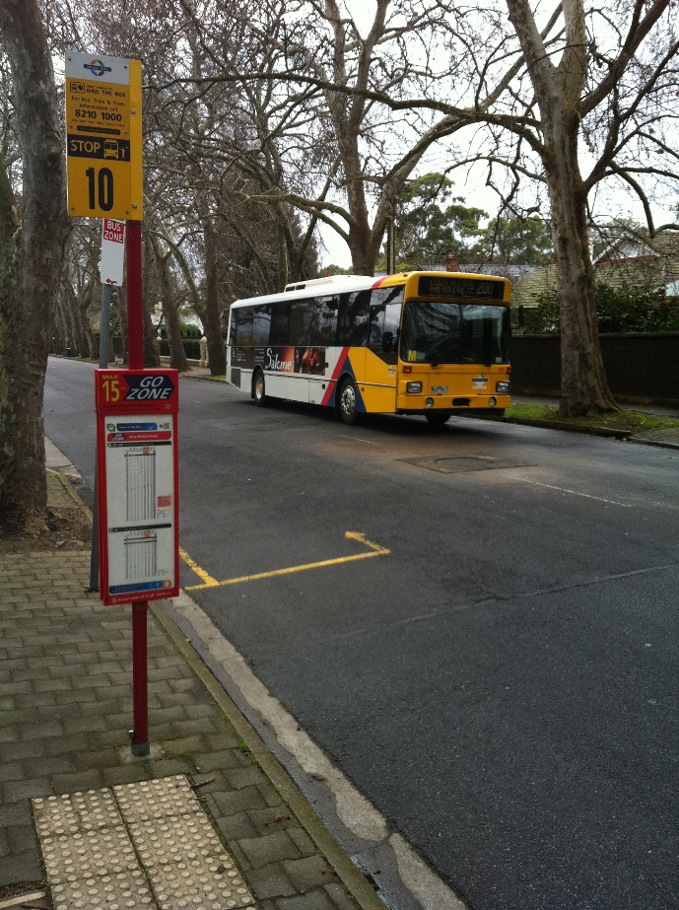
Victoria St, Unley Park – Adelaide, South Australia
Project Overview:
Client: Southside Hire Pty Ltd/ SA Water
Project:
Sewerage Manhole Cover Replacement –Victoria St, Unley, SA
Problem:
Existing ductile iron cover sitting low in frame.
Rattling of cover in frame & signs of surrounding structure failure.
Need:
Gas tight/ water tight, lightweight, easy to inspect, strong pit lids
Must withstand heavy vehicle traffic
Solution:
Terra Firma E400 ER-60 composite frame & cover - with precast concrete surround.
Gas tight/ water tight seal. Cover weight 28kg
NATA tested to AS3996 Class E (400kN).
Composite fibreglass materials suitable for aggressive H2S environments.
Can be opened in seconds with specialised seal breaker / lifter.
,

Slide 5
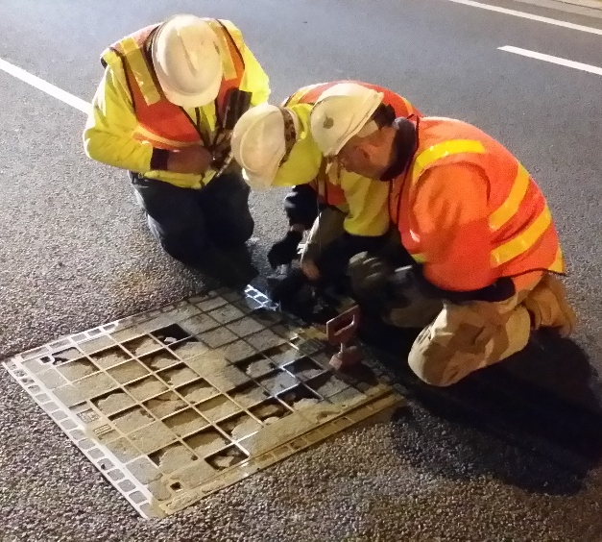
Princes Freeway, Montague St On-Ramp, Victoria
Client: VicRoads, Victoria, Australia
Project Overview:
Project:
Montague St/ Bolte Bridge On Ramp (West Bound)
Problem:
Rapid failure of ductile iron/concrete infill pit lids. Potential for dangerous concrete projectiles as covers deteriorate.
Expensive maintenance costs - requiring lane closures & traffic management,
& OH&S risks associated with heavy ductile iron/ concrete infill lids.
Need:
Strong & durable (able to withstand heavy freeway traffic), light weight pit lids.
Ease-of-access, addresses OH&S considerations.
Solution:
Terra Firma E400 ER-90
Cover weight 46kg
NATA tested to AS3996 Class E (400kN)
Secure & lockable, and can be easily opened in seconds.
,

Slide 6
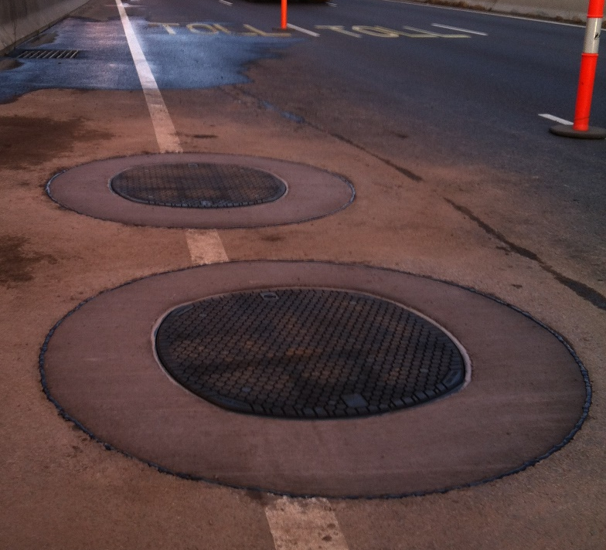
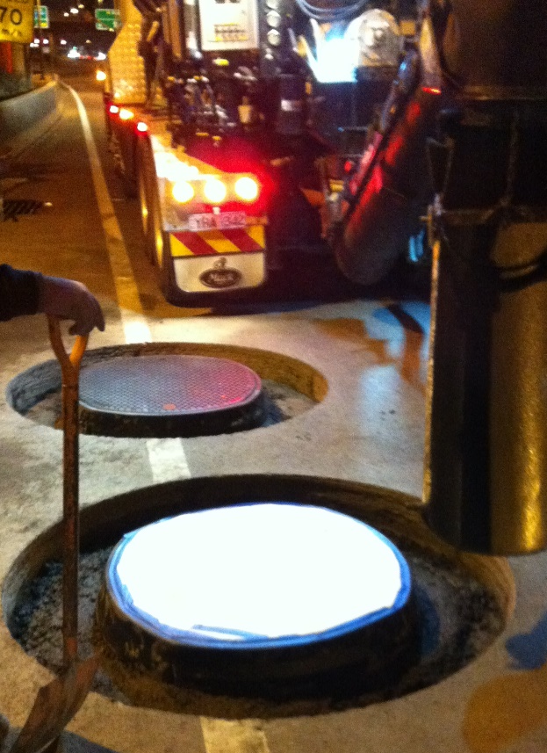
Princes Freeway, Montague St On-Ramp, Victoria
Installation Photos:
Client: VicRoads, Victoria, Australia
,

Slide 7
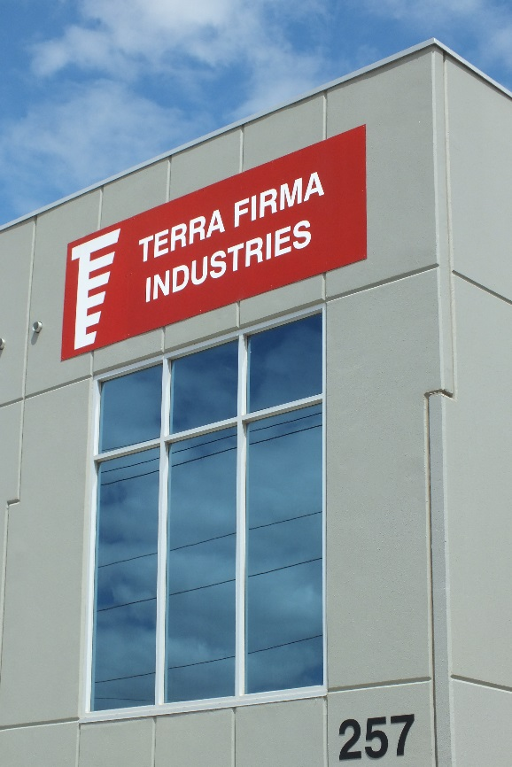
CONTACT DETAILS
Terra Firma Industries
257 Holt Parade,
Thomastown VIC 3074
Phone: 03 9464 6169
Fax: 03 9464 0522
Email: info@terrafirmapitlids.com
Web: www.terrafirmapitlids.com

